Slide 1



Slide 2
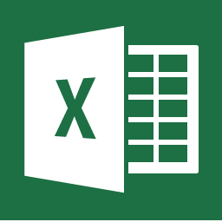
Hello excel

Slide 3
What is excel?
Excel is a spreadsheet program from Microsoft and a component of its Office product group for business applications. Microsoft Excel enables users to format, organize and calculate data in a spreadsheet.

Slide 4
Who use excel?
collection and verification of business data;
business analysis;
data entry and storage;
data analysis;
performance reporting;
strategic analysis;
accounting and budgeting;
administrative and managerial management;
account management;
office administration

Slide 5
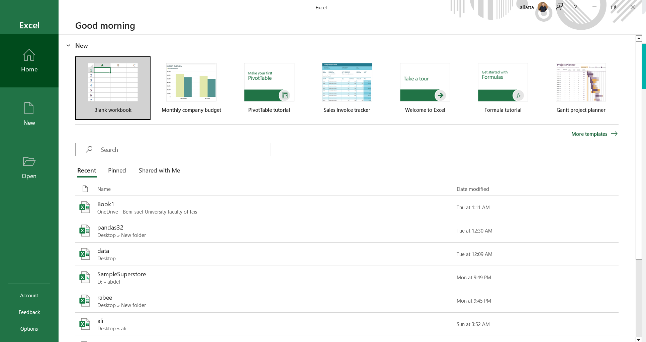
Lets start with the excel overview

Slide 6
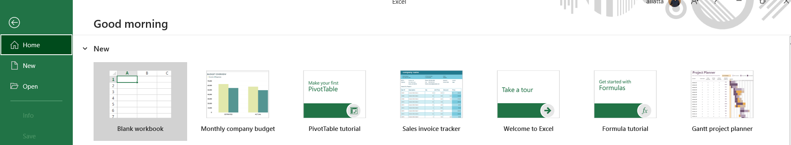
How to open a new file?

Slide 7
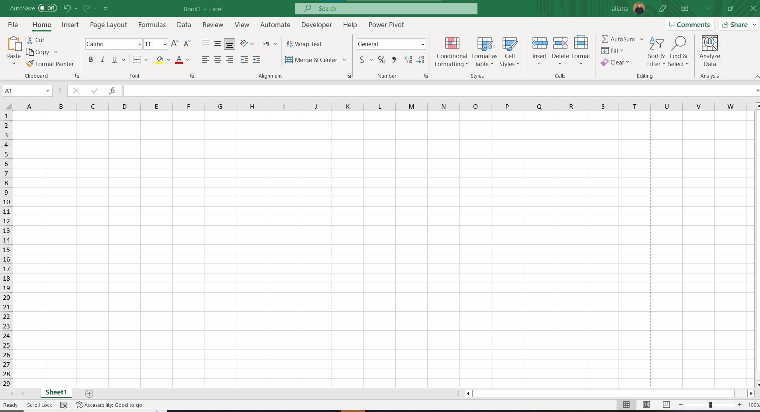
Look what will happen

Slide 8
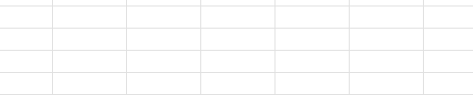
THE CELL IN EXCEL
Cell the intersection of row and column in work sheet

Slide 9
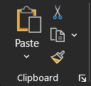
The clibboard

Slide 10
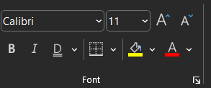
font

Slide 11
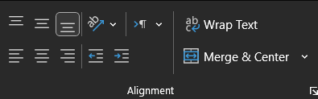
alignment

Slide 12
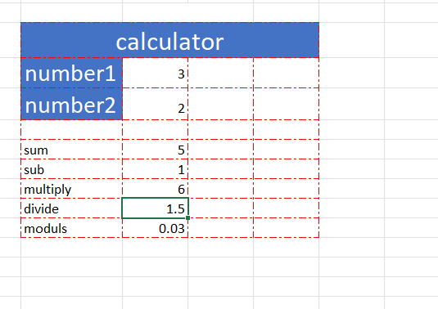
Simple program

Slide 13
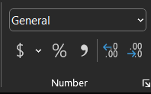
Numbers

Slide 14
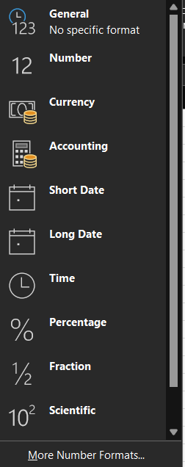
We will take about defining the data types

Slide 15
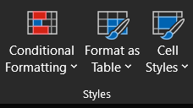
style

Slide 16
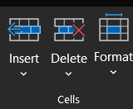
cells

Slide 17
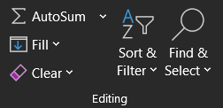
editing

Slide 18

Analyze data

